Slide 1


CAPSTONE PROJECT
Cloud-Based Student Performance Management System using Microsoft Azure
Presented By : - donthu harshavardhan
Student Name :- donthu harshavardhan
College Name :- bits – (jntua) - kurnool
Department :- cse
Email ID: donthuharsh2004@gmail.com

Slide 2
OUTLINE:
Problem Statement
Proposed System/Solution
System Development Approach
Algorithm & Deployment
Result
Conclusion
Future Scope
References

Slide 3
Problem Statement:
Educational institutions often face difficulty in managing, analyzing, and accessing student academic performance data efficiently.
Traditional systems are manual, error-prone, and lack real-time access, scalability, and data security.
There is a need for a cloud-based, centralized system to store, retrieve, and analyze student performance data securely and efficiently

Slide 4
Proposed Solution:
The proposed system is a cloud-based Student Performance Management System built using Microsoft Azure services.
It provides a centralized platform to store, manage, and analyze student marks securely.
The system enables:
Secure storage of student academic records in Azure SQL Database
RESTful API developed using Python Flask
Data access and management through a web-based dashboard
Cloud deployment using Azure App Service
Scalability, reliability, and real-time accessibility
This solution reduces manual effort and improves data accuracy and availability.

Slide 5
System Approach:
The project follows a modular and cloud-first development approach.
Steps involved:
Requirement Analysis
  Identify data fields (StudentID, Name, Semester, Subject, Marks, TotalMarks)
  Define functional requirements (CRUD operations, filtering, dashboard access)
Database Design
  Design relational schema using Azure SQL Database
  Create StudentMarks table with appropriate data types
Backend Development
  Develop REST APIs using Python Flask
  Implement CRUD operations (Add, View, Update, Delete)
  Connect Flask to Azure SQL using pyodbc
Frontend Development
  Build simple HTML templates (Login, Dashboard, Add/Edit Student)
  Integrate frontend with backend APIs
Cloud Integration
  Deploy application on Azure App Service
  Configure environment variables securely
CI/CD & Deployment
  Source code hosted on GitHub
  Automated deployment using GitHub Actions

Slide 6
Algorithm & Deployment:
Algorithm
The system uses a rule-based data processing approach (no ML model).
Algorithm Flow:
User sends a request (login / add / update / delete / view records)
Flask API validates input data
SQL queries are executed on Azure SQL Database
Retrieved data is processed and formatted
Response is sent back to the frontend/dashboard
Key Operations:
INSERT → Add student marks
SELECT → Fetch student records & filters
UPDATE → Modify existing records
DELETE → Remove records

Slide 7
Deployment
Backend deployed on Azure App Service
Database hosted on Azure SQL Database
Secure connection via environment variables
CI/CD implemented using GitHub Actions
Application accessible via public Azure URL

Slide 8
Result:
Successfully developed and deployed a cloud-based student performance system
Student data is stored securely in Azure SQL Database
Users can add, view, update, and delete student marks through the web interface
REST APIs respond in real time with accurate data
Application is accessible globally using an Azure-hosted URL
GitHub-based deployment ensures smooth updates and version control
The system works reliably with proper authentication and database connectivity.
Git Hub repo link:https://github.com/Harshavardhandonthu/StudentPerformanceAPI.git

Slide 9
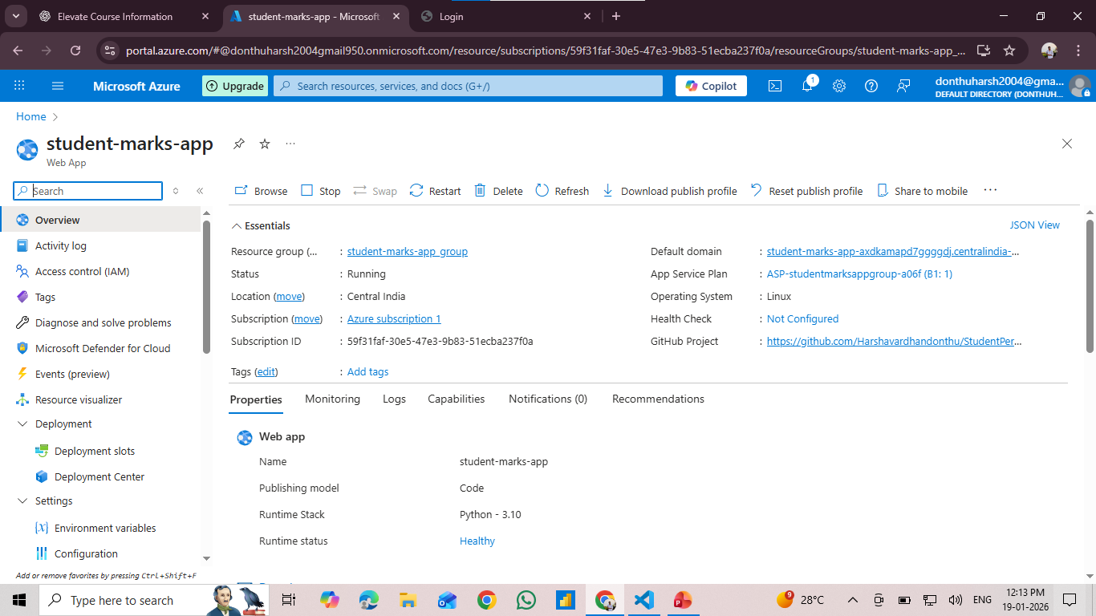

Slide 10
Conclusion:
The Cloud-Based Student Performance Management System successfully demonstrates the use of Microsoft Azure for building and deploying a scalable web application.
By integrating Flask, Azure SQL Database, and Azure App Service, the system provides secure and efficient management of student academic data.
The project highlights practical knowledge of:
Cloud computing concepts
Backend development
Database management
CI/CD deployment using GitHub
Overall, the solution meets the project objectives and provides a reliable cloud-based data management platform.

Slide 11
Future scope:
The system can be further enhanced with the following features:
Role-based authentication for Admin, Faculty, and Students
Advanced analytics and visualization using Power BI
Export reports in PDF or Excel format
Integration of machine learning for performance prediction
Mobile-friendly user interface
Deployment using Docker and Azure Container Services
These enhancements will improve scalability, usability, and analytical capabilities.

Slide 12
References:
Microsoft Azure Documentation
https://learn.microsoft.com/azure
Flask Official Documentation
https://flask.palletsprojects.com
Azure SQL Database Documentation
https://learn.microsoft.com/azure/azure-sql
GitHub Actions Documentation
https://docs.github.com/actions
Python Official Documentation
https://www.python.org/doc/

Slide 13
Thank You

